Slide 1


ENVIRONMENT AND SUSTAINABILITY
UNIT 5: Corporate Social Responsibility (CSR)
COURSE CODE: CV242AT

Slide 2
CSR- Corporate Social Responsibility
CSR can be defined as a Company’s sense of responsibility towards the community and environment (both ecological and social) in which it operates.
CSR is a way of conducting business, by which corporate entities visibly contribute to the social good. Socially responsible companies do not limit themselves to using resources to engage in activities that increase only their profits.

Slide 3
CSR- Corporate Social Responsibility
Definition: Corporate Social Responsibility (CSR) is a business model in which companies integrate social and environmental concerns into their operations and interactions with stakeholders.
WBCSD (World Business Council for Sustainable Development) “The continuing commitment by business to behave ethically and contribute to sustainable economic development while improving the quality of life of the workforce and their families as well as of the local community and society.”

Slide 4
PURPOSE OF CSR
The purpose of CSR is to make corporate business activities sustainable in its three Dimensions
Economic
Social
Environmental
CSR’s purpose is to ensure that companies ethically conduct their business this means taking account of their social, economic, and environmental impact and consideration of human rights.
It can involve a range of activities such as working in partnership with local communities.
Now, CSR has become one of the standard business practices of our time.

Slide 5
Basic Constituents of CSR
Contribute towards a sustainable economic development
Make desirable social changes
Towards Business & Society
Global Environmental Protection

Slide 6
History & evolution of CSR
Howard Bowen, an American economist and Grinnell College president, is often cited as the “father of CSR.”
At first, CSR focused primarily on philanthropic activities and charitable giving.
They understood that their success was intertwined with the well-being of the society around them.
Things got more interesting in the 1960s when scholars started looking at CSR as a response to society's issues, prompting businesses to integrate responsible practices.
In 1970s and 80s, CSR became more integrated into business operations, driven in part by reduced government regulation.
In the 1990s, International events and agreements, such as Agenda 21 and the Kyoto Protocol, compelled multinational corporations to broaden their CSR focus beyond local concerns.

Slide 7

Charity
Charity typically refers to the voluntary giving of help to those in need, typically in the form of money. It is usually motivated by compassion and a desire to help others without expecting anything in return.
Examples: Donations to food banks, disaster relief funds, and medical research foundations.

Slide 8

Corporate philanthropy
Corporate Philanthropy involves businesses donating resources, such as money, products, or employee time, to charitable causes.
It is often part of a company’s broader CSR strategy but is more focused on direct charitable contributions.
Focus: Financial and in-kind donations to support non-profit organizations and community programs.
Examples: Sponsoring educational scholarships, funding community health initiatives, and supporting arts and culture programs.
Types of Corporate Philanthropy
Matching Gifts: Matching gift programs are a popular form of corporate philanthropy where companies match the charitable contributions of employees to eligible non-profit organizations.

Slide 9
Volunteer Grants: Volunteer grant programs, also known as ‘Dollars for Doers’ or ‘Volunteer Time Off’ (VTO) grants, are the amount paid by companies to Nonprofits Organizations based on hours spent by its employees volunteering for a specified nonprofit.
Community Grants: The community grants can be contributed in both in-kind assistance as well as financial support depending upon the company’s budget and guidelines.
Employee Grants Stipends: Such kind of grants are temporarily provided to the employees by the company in case of any medical emergencies, natural disasters, personal crises, unexpected expenses, or more.
Volunteer Support Initiatives: This is a corporate philanthropy that encourages employees’ morale by rewarding them for active participation in volunteering activities in company-specified non-profit organizations.

Slide 10
Donations
1. Financial donations
2. In-Kind Donations
Corporate Scholarships: Corporate scholarships are a type of corporate philanthropy in which companies provides educational grants in the form of financial rewards to academic pursuits in the academic realm which includes students.
Cause-related Corporate Philanthropy: When companies contribute a part of their earnings to non-profit, charitable, and social organizations associated with them and which aligns with companies’ objectives and goals to increase visibility in the market as well as contribute to society’s well-being, it is called cause-related marketing.

Slide 11
Benefits of Corporate Philanthropy
Government Support
Tax Benefits National
Recognition Builds
Community Assistance
Increased Sales
Employee Engagement
Enhances Productivity
Stronger Customer Relation

Slide 12
Corporate citizenship
Corporate citizenship refers to a company’s responsibilities toward society.
Corporate citizenship is growing increasingly important as both individual and institutional investors begin to seek out companies that have socially responsible orientations such as their environmental, social, and governance (ESG) practices.
Companies go through increasing stages during the process of developing corporate citizenship.

Slide 13
Corporate citizenship
The five stages of corporate citizenship are defined as:
Elementary
Engaged
Innovative
Integrated
Transforming

Slide 14
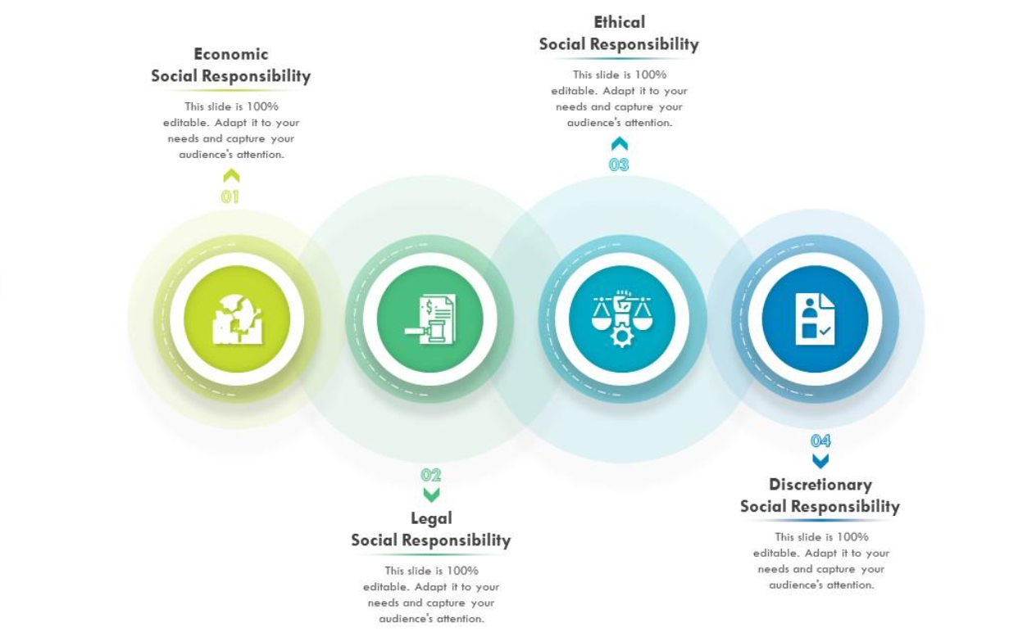
CSR-an overlapping

Slide 15
Sustainability & Stakeholder Management
Sustainability
Sustainability and corporate social responsibility (CSR) are two terms that often get talked about as the same thing.
Both CSR and sustainability focus on how an organisation impacts the environment and society around it.
CSR is more concerned with looking back and reporting on what an organization has done, whereas sustainability looks forward and is more focused on the company’s ability to survive long into the future.
Both CSR and sustainability cover three main areas: environment, society and economy.
Where CSR is focused on reporting on these areas, sustainability is focused on acting on these areas.

Slide 16

Sustainability & Stakeholder Management
Stakeholders
One of the first steps in launching a CSR initiative is to identify all the company’s stakeholders.
Stakeholders play a crucial role in shaping a company’s corporate social responsibility journey.
Identifying stakeholders can take some time as there are so many of them! In the past, we tended to talk first and foremost about ‘shareholders’.
Stakeholders are all the physical or legal entities that interact with a company and its business.

Slide 17
Relation between CSR and Corporate Governance
Corporate governance refers to the system of rules, practices, and processes by which a company is directed and controlled.
Corporate social responsibility entails a company’s commitment to behaving ethically and contributing to the economic development while improving the quality of life of its employees, their families, the local community, and society at large.
The relationship between corporate governance and CSR is symbiotic, with each reinforcing and supporting the other. Here are key areas where they intersect:
Alignment of Interests: Effective corporate governance ensures that the interests of various stakeholders, including shareholders, employees, customers, and the community, are aligned with the long-term objectives of the company.

Slide 18
Relation between CSR and Corporate Governance
Transparent Decision-Making: Corporate governance promotes transparency and accountability in decision-making processes.
Accountability and Ethical Behavior: Corporate governance holds directors, executives, and employees accountable for their actions.
Long-Term Value Creation: Both corporate governance and CSR emphasize long-term value creation over short-term gains.
Reputation and Stakeholder Trust: A robust corporate governance framework combined with meaningful CSR initiatives enhances a company’s reputation and fosters stakeholder trust.

Slide 19
The Environmental aspect of CSR
Energy Consumption and Greenhouse Gas Emissions: Companies should strive to reduce their energy consumption by implementing energy-efficient practices and investing in renewable energy sources.
Waste Management and Pollution: Companies should adopt sustainable waste management practices, such as recycling materials, reducing packaging waste, and implementing proper disposal methods for hazardous materials.
Conservation of Natural Resources: Companies have a responsibility to conserve natural resources, which are finite and essential for the well-being of our planet. To address this aspect of CSR, companies should implement resource-efficient strategies.

Slide 20
Environmental aspect of CSR
Climate Change Mitigation and Adaptation: Climate change is a pressing global challenge, and companies play a significant role in addressing it. Additionally companies should also focus on adapting to the impacts of climate change by developing resilience plans, such as implementing flood protection measures and creating disaster response protocols.
Environmental Education and Awareness: Promoting environmental education and awareness is an essential aspect of CSR. Companies can engage in initiatives that aim to educate their employees, customers, and the community about environmental issues and the importance of sustainable practices.

Slide 21
Chronological evolution of CSR in India
The evolution of CSR in India highlights changes in corporate engagement to create a positive impact on communities, cultures, societies, and environments, beyond mere profit-making.
CSR in India emphasizes that corporations, along with public policy, should address social issues and challenges typically managed by the state.
India has a rich tradition of CSR, with early practices focused on charity and philanthropy by influential merchants and firms like TATA and Birla.
The second phase during India's independence saw industrialists encouraged to manage their wealth for societal benefit, inspired by Mahatma Gandhi's notion of "trusteeship."

Slide 22
Chronological evolution of CSR in India
Post-independence, CSR saw a shift towards public sector control, aiming for equal distribution of resources and social development in a mixed economy.
The current phase of CSR began in the 1980s with globalization and economic liberalization, boosting the Indian economy and aligning corporate practices with international standards.
Despite progress, CSR in India still needs widespread recognition, requiring companies to integrate CSR into their core business strategies, set clear objectives, and publicly report performance.
Recent efforts have focused on making Indian entrepreneurs aware of the importance of CSR as a key segment of their business activities.

Slide 23
Sustainability Reporting
Sustainability reporting has no set format, but broadly involves disclosure of a company’s environmental, social, and governance (ESG) goals and communicating the company’s progress and efforts to reach those goals.

Slide 24
Sustainability Reporting
Global Reporting Initiative (GRI): Global Reporting Initiative (GRI) is one of the most widely used frameworks for sustainability reporting. It provides comprehensive guidelines for companies to disclose their environmental, social, and economic impacts.
Dow Jones Sustainability Index (DJSI): Dow Jones Sustainability Index (DJSI) is a family of indices that evaluates the sustainability performance of companies based on environmental, social, and economic criteria. It includes global, regional, and country-specific indices.

Slide 25
Comprehensive Environmental Performance Index (CEPI)
The CEPI (Comprehensive Environmental Performance Index) of CSR (Corporate Social Responsibility) is a metric used to evaluate a company's environmental performance as part of its CSR activities. The CEPI measures how effectively a company manages its environmental impact and integrates sustainable practices into its operations.

Slide 26
Investor Interest in Sustainability
Investors are increasingly recognizing the importance of sustainability in driving long-term value and managing risks.
Investor interest in the sustainability of corporate social responsibility (CSR) has grown significantly in recent years.
Investors are increasingly aware that companies addressing environmental, social, and governance (ESG) issues are better positioned to meet evolving consumer demands for ethical and sustainable products.
The use of ESG performance metrics allows investors to identify resilient companies well-prepared for future challenges.
Ultimately, the growing investor interest in CSR sustainability reflects a broader commitment to responsible investing, where financial success is intertwined with positive societal and environmental outcomes.

Slide 27
THANK YOU

